Slide 1
A New Day for Microsoft
Presented by Michael Pozo

Slide 2
The Business Question If Microsoft enters the movie space, how should they invest?

Slide 3
My Approach
Select the best time to release movies in theaters based on worldwide box office sales
Uncover the movie genre that performed the best during these time periods
Create a shortlist of directors in this genre based on ROI and profitability
Project how much Microsoft needs to spend based on the production budget – profit correlation

Slide 4


The Data
Movie Titles
Director Names
Genres
Production Budgets
Domestic Sales
Worldwide Sales
Release Date
Final Sample: 1536 Movies

Slide 5
Recommendations

Slide 6
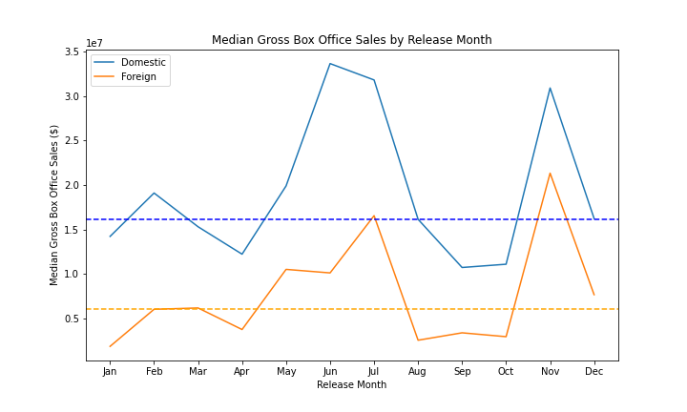
Target an Early Summer or November Release Date
Box office sales peak in June, July and November
Trend holds true for domestic and foreign markets
Recommend targeting peak months to reach the largest audience and maximize sales
Domestic Median
Foreign Median

Slide 7
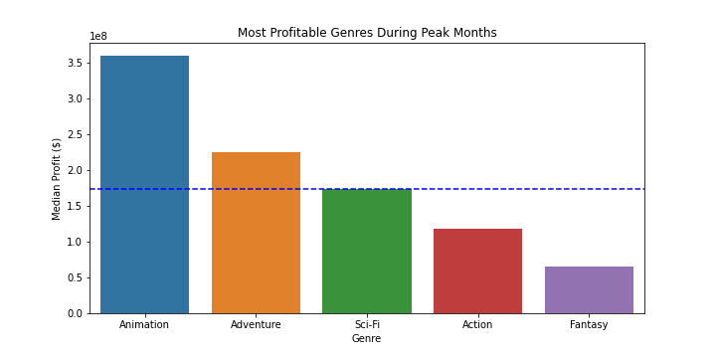
Invest in the Animation Genre
106% Greater Profit than Median
Median Profit

Slide 8


Animation Director Shortlist
The following animation directors were ranked in the top 10 in both profit and ROI and should be priority targets when choosing a director (minimum 2 productions in last 10 years)
Director
Pierre Coffin
Lee Unkrich
Dean DeBlois
Gennedy Tartakovsky
Tom McGrath
Chris Sanders
Mike Thurmeier
Raja Gosnell
Carlos Saldanha
Mike Mitchell
Pierre Coffin
Director of Despicable Me and Minions Franchises
Most Profitable and ROI Positive Director
Mike Thurmeier
Director of Ice Age Franchise
Top 3 in both ROI and Profit categories

Slide 9
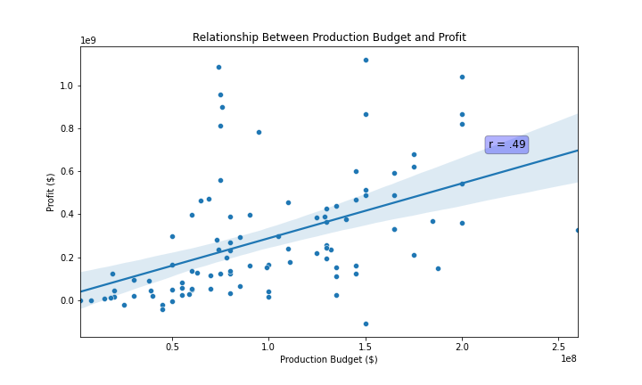
Medium Size Budget Can Return Outsized Profit
Moderately positive correlation between production budget and profit in the animation genre
Middle 50% of budgets have a high concentration of outsized profits
Opportunity to make money without spending beyond the average genre budget

Slide 10
Thank You!!
Questions??

